Slide 1
Data Structures. (H16Y 35)
Week 4_5 (Block 2)

Slide 2
To Cover …
Binary Search Tree (BST) – Intro
BST Operation
BST Algorithms

Slide 3
Data Structures.
Binary Search Tree (BST) – Intro.

Slide 4
Binary Search Trees
A binary tree is either empty or it is a root node together with two subtrees, the left subtree and the right subtree, each of which is a binary tree.
The binary tree is full if each level, except the last, contains as many nodes as possible. Therefore a binary tree is complete if each level contains as many nodes as possible. Binary trees have the following three distinctive characteristics
Each node has at most two children (subtrees).
Each subtree is identified as either the left-subtree or the right-subtree of the parent.
A binary tree may be empty.

Slide 5

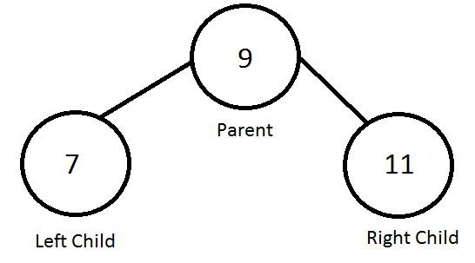
Binary Search Tree (BST) - Intro
Computer scientists normally draw trees from the root node down—exactly the opposite of the way most trees grow in nature

Slide 6
Data Structures.
Binary Search Tree (BST) – Definition

Slide 7
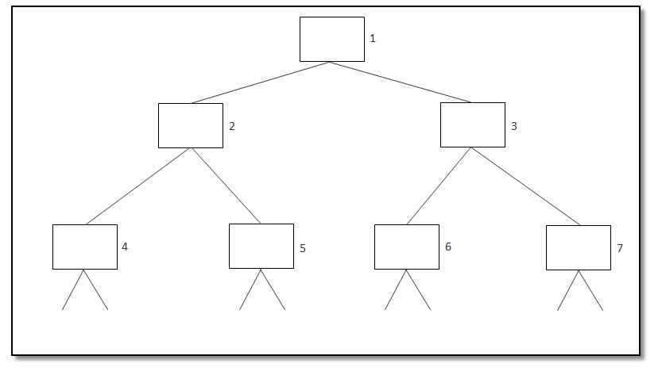
Binary Search Trees (BST)
A binary tree is a data structure composed of zero or more nodes. Each node contains
A value (some kind of data item)
A reference or pointer to a left child (may be null)
A reference or pointer to a right child (may be null)

Slide 8
Binary Search Trees (BST)
A binary tree is defined as a tree where each node can have no more than two children.
A Binary Search Tree (BST) is a tree in which all the nodes follow the below-mentioned properties −
The left sub-tree of a node has a key less than or equal to its parent node's key.
The right sub-tree of a node has a key greater than to its parent node's key.
Thus, BST divides all its sub-trees into two segments; the left sub-tree and the right sub-tree.

Slide 9
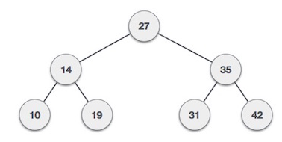
BST - Representation
BST is a collection of nodes arranged in a way where they maintain BST properties.
Each node has a key and an associated value. While searching, the desired key is compared to the keys in BST and if found, the associated value is retrieved.
We observe that the root node key (27) has all less-valued keys on the left sub-tree and the higher valued keys on the right sub-tree.

Slide 10
Data Structures.
BST Operations

Slide 11
Basic BST Operations
Search - Used to search for data or elements in a tree
Insert – Used to insert an element or data in a tree
Pre – Order Traversal - Scans or searches through a tree in a pre-order manner i.e. each node is processed before any nodes in its subtrees
In – Order Traversal – Scans or searches through a tree in an in-order manner i.e. each node is processed after all nodes in its left subtree but before any nodes in its right subtree.
Post – Order Traversal - Scans or searches a tree in a post-order manner i.e. each node is processed after all nodes in both its subtrees
Delete – Used to delete or remove an element from the tree

Slide 12
Data Structures.
BST Algorithm

Slide 13
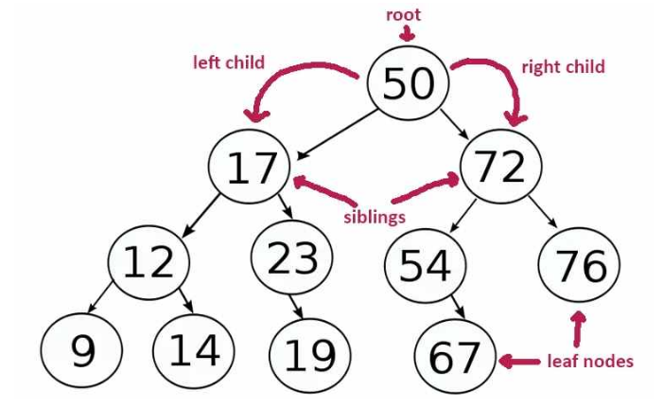
BST Algorithm
A BST can also be defined as a tree where each node can have no more than two children.
By limiting the number of children to 2, we can write efficient programs for inserting data, deleting data, and searching for data in a binary tree.

Slide 14
How BST Algorithm Works
Once we’re inside the BST, the next step is to determine where to put the new node.
This is performed inside a while loop that we break once we’ve found the correct position for the new node.
The algorithm for determining the proper position for a node is as follows:

Slide 15
How BST Algorithm Works
Set the parent node to be the current node, which is the root node.
If the data value in the new node is less than the data value in the current node, set the current node to be the left child of the current node. If the data value in the new node is greater than the data value in the current node, skip to Step 4.
If the value of the left child of the current node is null, insert the new node here and exit the loop. Otherwise, skip to the next iteration of the While loop.
Set the current node to the right child node of the current node.
If the value of the right child of the current node is null, insert the new node here and exit the loop. Otherwise, skip to the next iteration of the While loop

Slide 16
Data Structures.
BST Examples

Slide 17
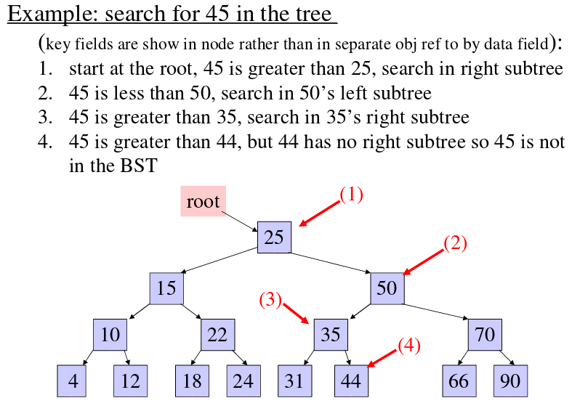
BST – Example 1 (Search)

Slide 18
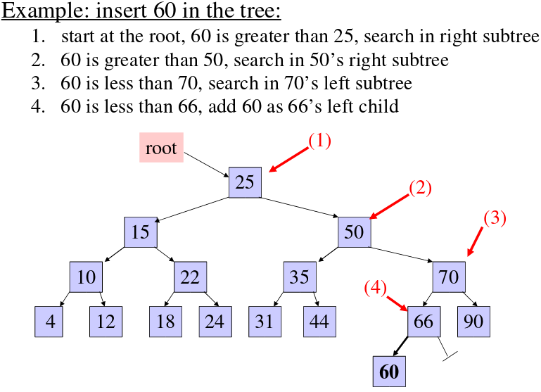
BST – Example 2 (Insert)

